Slide 1
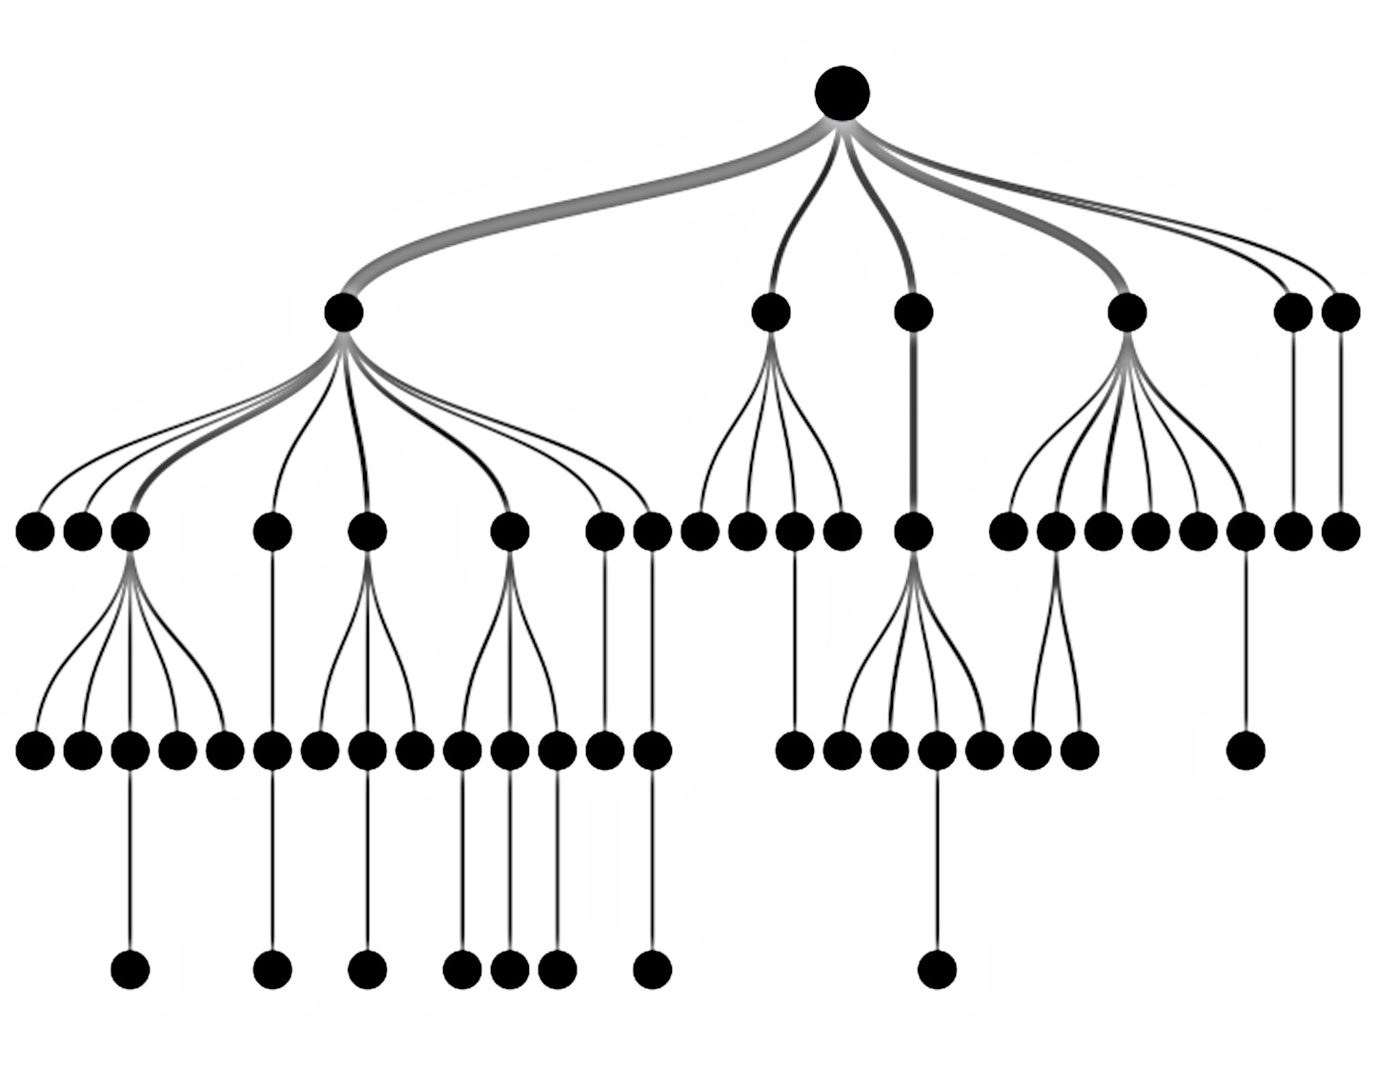
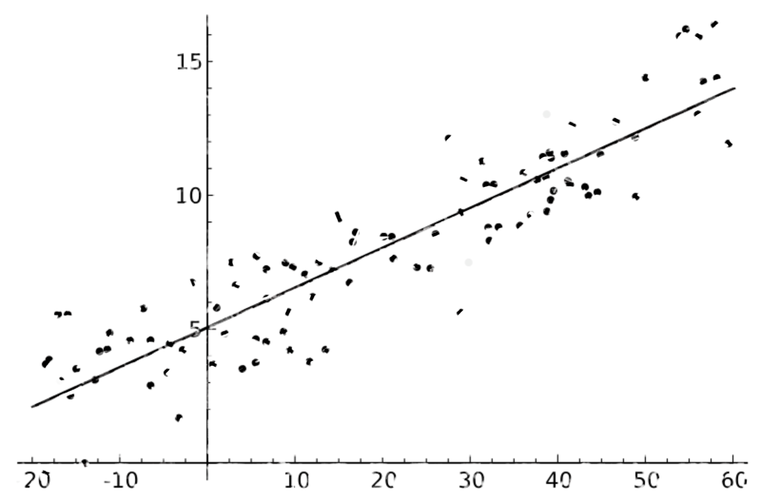
Predicting Online news popularity
Springboard Capstone project presentation
By
Tushar Prakash

Slide 2
introduction
The age of social media has brought along with it a major disruption in how news content is disseminated and consumed.
For many, Facebook and Twitter are now the most common sources of news.
Digital Media companies that deal specifically with curating online news and entertainment content from around the web are on the rise.
To select the best content, they need to have an ability to accurately predict the number of shares a news article may get on social media.
Mashable.com is one such website, that combines news and entertainment content from around the world.

Slide 3



Slide 4


objective
This project deals with predicting online news popularity, using data from Mashable.com.
Data Set is taken from UCI Machine Learning Repository.
The stated goal is to predict whether the number of shares for a news article will be less than or greater than 1400.
I will go beyond the stated goal to study feasibility of predicting exact values, or a more granular classification.
I will also try to find why Mashable has drawn the lines of it’s classification problem at 1400.

Slide 5
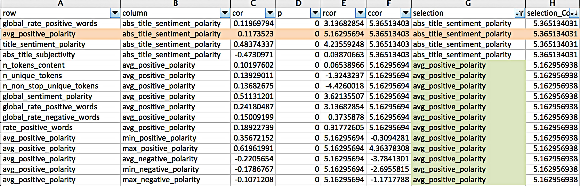
Data analysis & Feature selection
Data contains over 39000 records containing 59 quantitative features
Data is a combination of categorical and continuous variables
Principal Component Analysis (PCA) was not suitable for feature selection due to multitude of data involved. I decided to forego Multi-Factor Analysis (MFA) as well due to concerns about over fitting the noise, and to keep the model interpretable.
Devised a dimensionality reduction strategy involving correlation analysis.
Using rcorr() function, obtained a correlation matrix. Flattened the matrix to obtain data in the below format

Slide 6
Dimension reduction Scheme
A, B, C | Independent Variables
Y | Dependent Variable
P Value | Statistical significance level of the correlation
ρ(X,Y) | Absolute value of correlation between variables X & Y
Wins(X) | No. of instances when X is the selected variable in primary analysis
ρ(A,B) > 10% & p<0.05?
ρ(A,Y) > ρ(B,Y)
& ρ(A,Y) > .01
Select A,
Reject B
Reject
ρ(B,C) > 10% & p<0.05?
ρ(B,Y) > ρ(C,Y) & ρ(B,Y) > .01
Select B,
Reject C
Primary Analysis
Wins(A) > Wins(B)
ρ(A,Y)
>
ρ(B,Y)
Select A
ρ(B,Y)
>
ρ(A,Y)
Select B
ρ(A,B)>> 0
If (Wins(A) > Wins(B)
Select A Else B
Select Both
Yes
No
No =>
B preferred
No =>
A preferred
Secondary Analysis

Slide 7
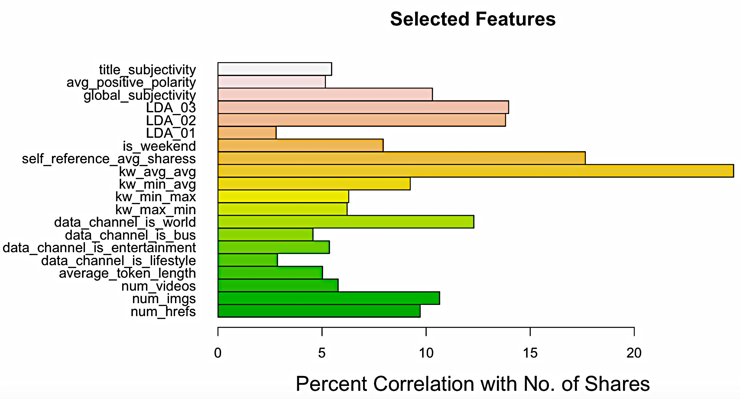
Feature Selection Results
The scheme described previously is a general guiding theme of the analysis. Final list of features selected was a result of empirical and subjective valuation of the features

Slide 8
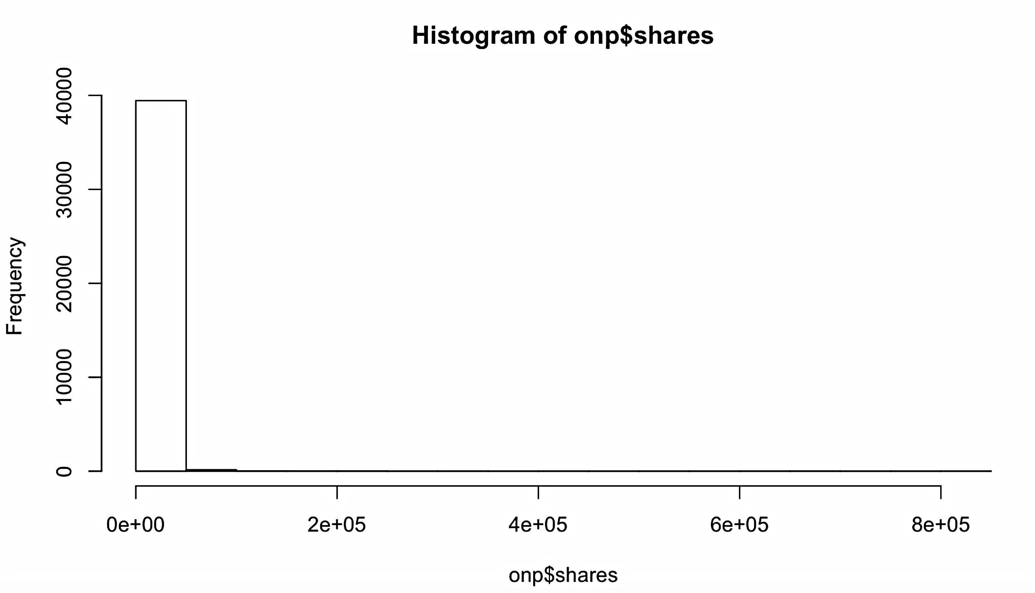
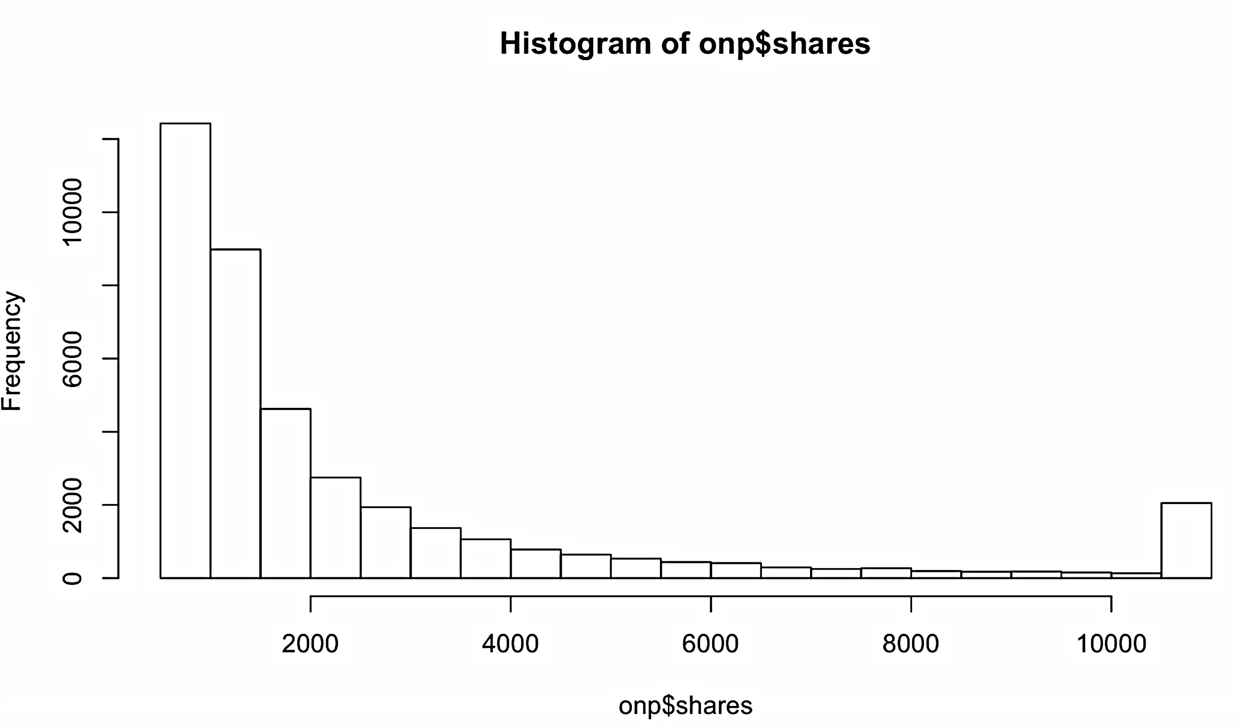
Data Preparation
Capping
Quantitative variables are capped to 5% and 95% quantiles
Outliers removed in the process as can be seen in the histogram
Scaling
Continuous variables are scaled including target variable
Classification
Binary classification based on 50-50 quantile distribution
4-way classification based on 30-30-20-20 distribution
Factorization
Categorical variables are factorized including class variables
Splitting
Data is split into training and test set based on a 75-25 split ratio
Before Capping
After Capping
Effects of Capping: Values are much better distributed after capping

Slide 9
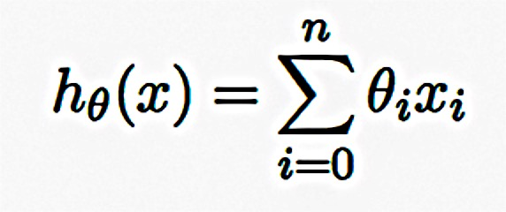
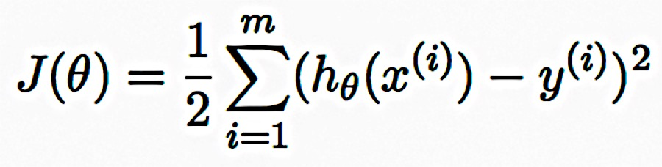
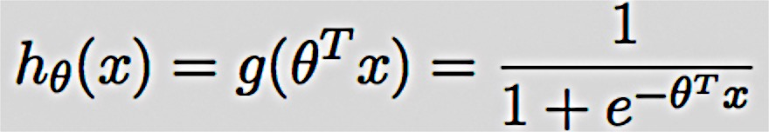
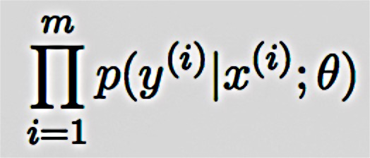
Data Modeling
Linear regression represents a least-square fit of the response to the data. It chooses the hypothesis by minimizing the cost function
For logistic regression, the hypothesis is and parameters are chosen as to maximize their likelihood
CART (Classification & Regression Trees) is a decision tree based supervised learning model. A decision tree splits the sample into two or more homogeneous sets at every node (decision node), based on most significant splitter / differentiator in input variables, to reach a set of pre-defined classes (leaf node). CART can be fine tuned by using a k-fold cross validation method that uses bootstrapping.
Methods used for modeling
Linear Regression for predicting exact values
Logistic Regression for binary classification
CART learning model using k-fold cross-validation on a binary classification
Random Forest learning model for both binary and 4-class problems
Results from each method
Linear regression produced a low R-squared of 10% implying that trying to predict exact values is not fruitful.
Logistic Regression preformed better than CART model as a binary classifier.
Random forest gave the best results for binary classification.

Slide 10
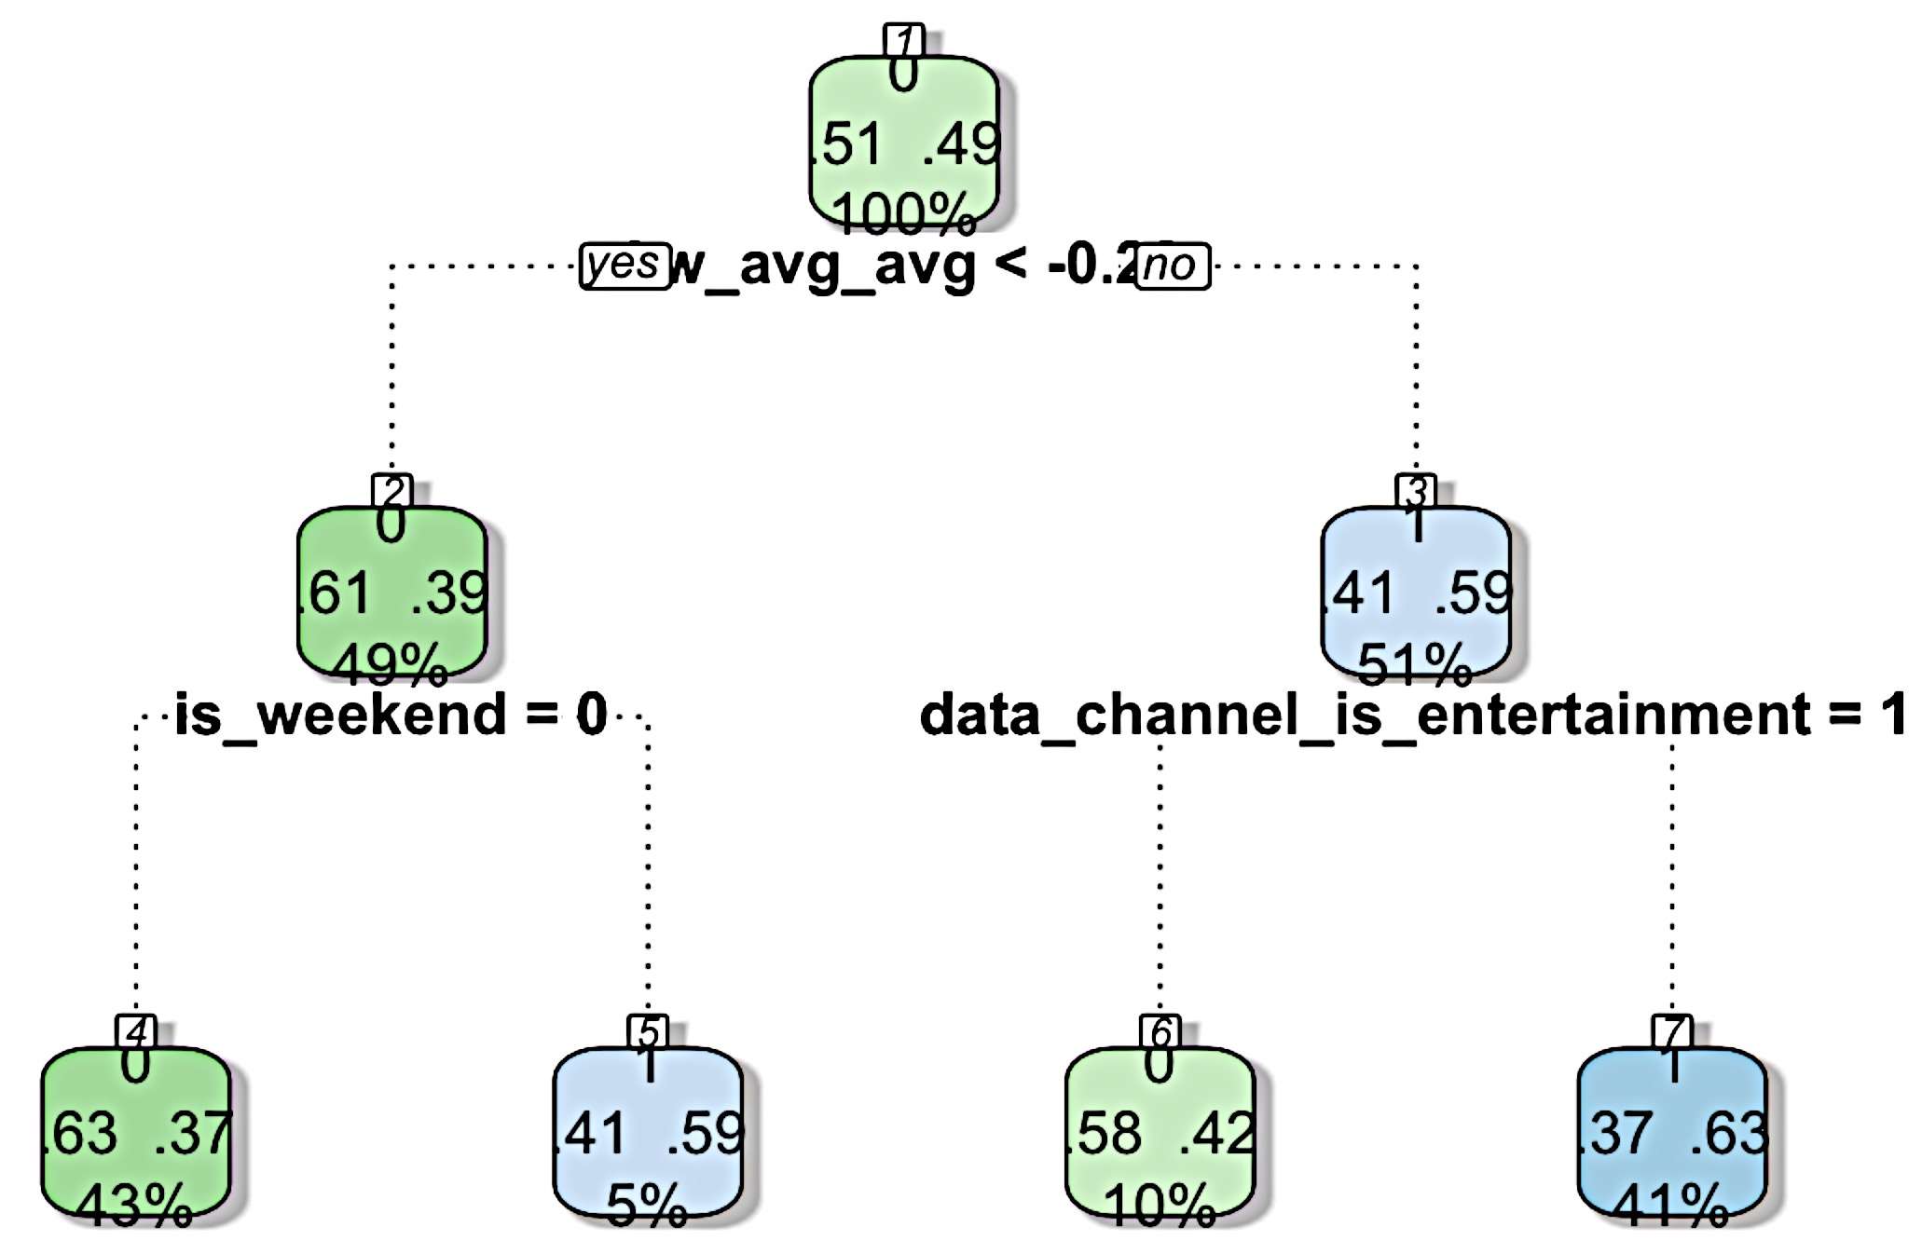
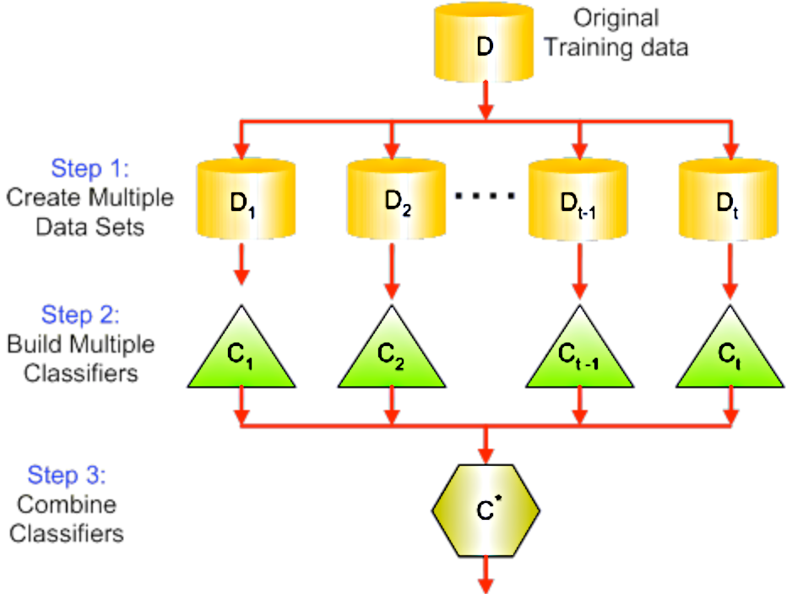
Random forest Classifier
Random Forest uses multiple decision trees which are built on separate sets of examples drawn from the dataset. Figure on the top right shows the actual decision tree obtained from the CART model used previously.
Random Forest uses a technique called bagging. For each tree, we use a subset of all the features we have (with replacement). By using more decision trees and averaging the result, the variance of the model can be greatly lowered as illustrated in the figure on bottom right.
Model parameters such as no. of trees to use, minimum leaf node size, which can govern the tree depth, and no. of features to sample at a time can all be customized and tuned.

Slide 11
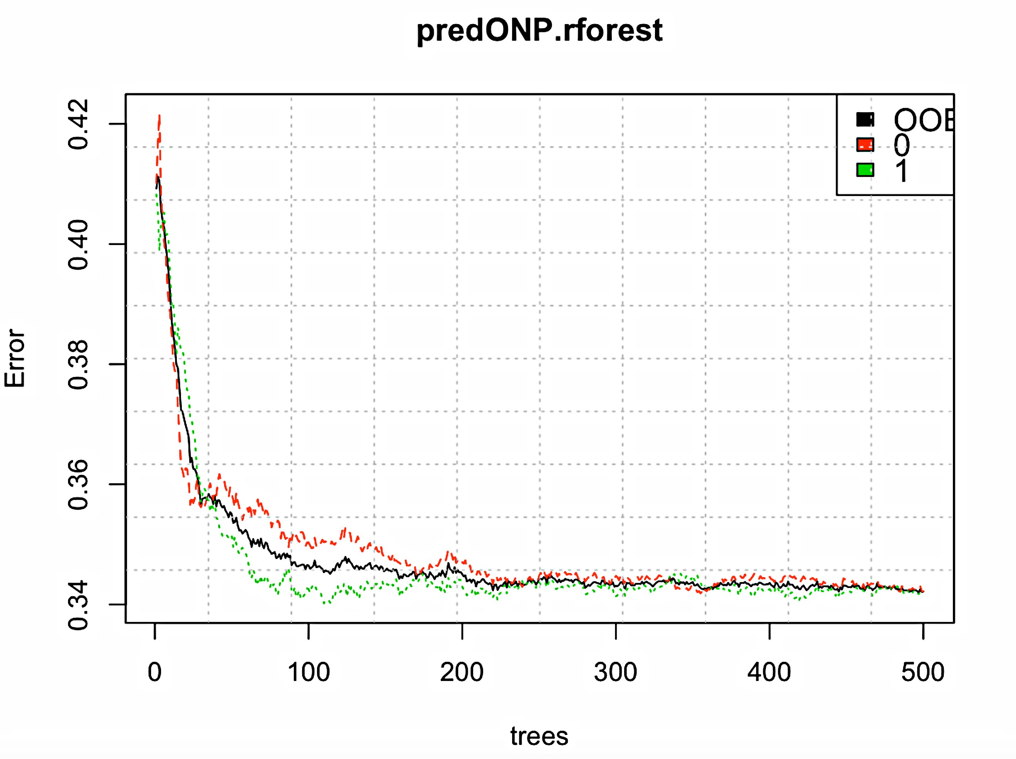
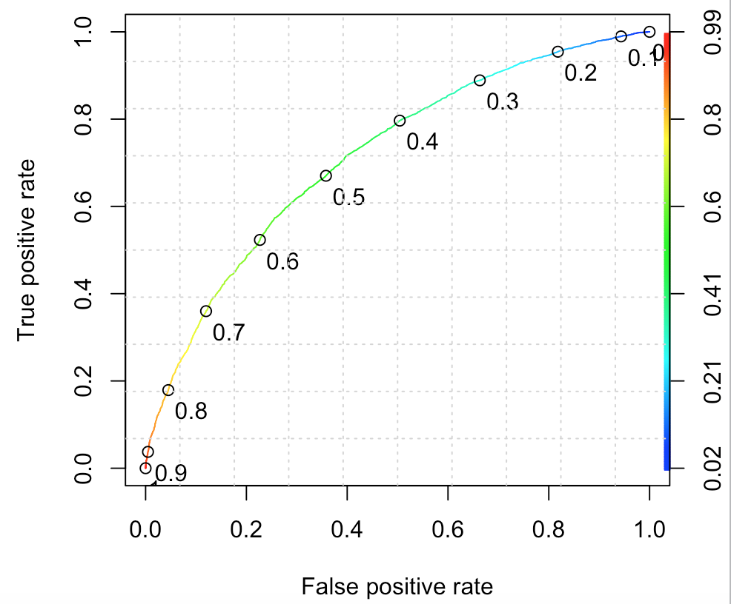
Results from Random Forest classifier
Figure below shows the ROC curve showing True Positive Rate vs. False Positive Rate from at different probability thresholds as shown in color gradation.
Area Under Curve (AUC) was 71.6%.
Accuracy obtained was 65.5%-65.9%
Figure below shows the mean error of the two classes (red and green) and Out-of-Bag error (black).
Error decreases with increasing number of trees (ntree parameter) and converges to a minimum at a value of 500 trees.

Slide 12
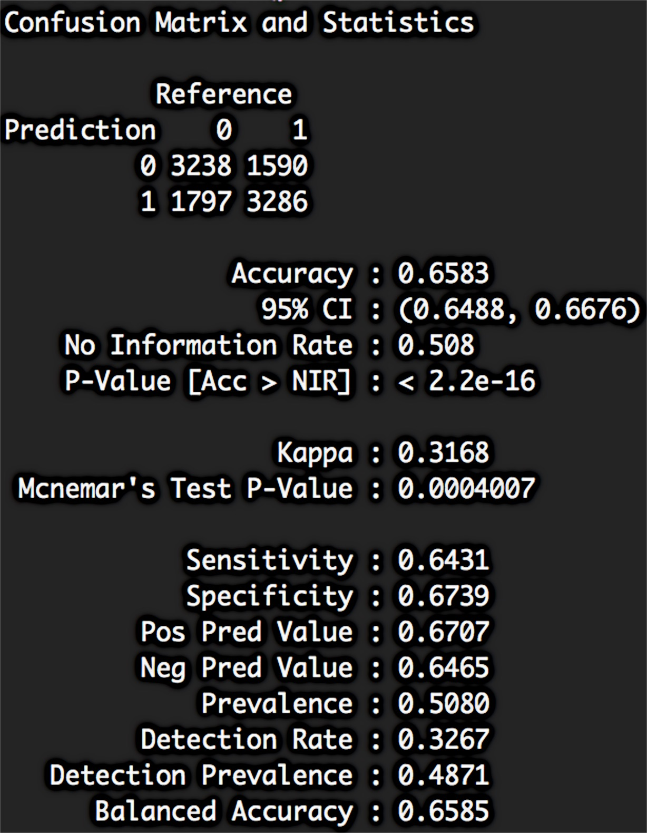
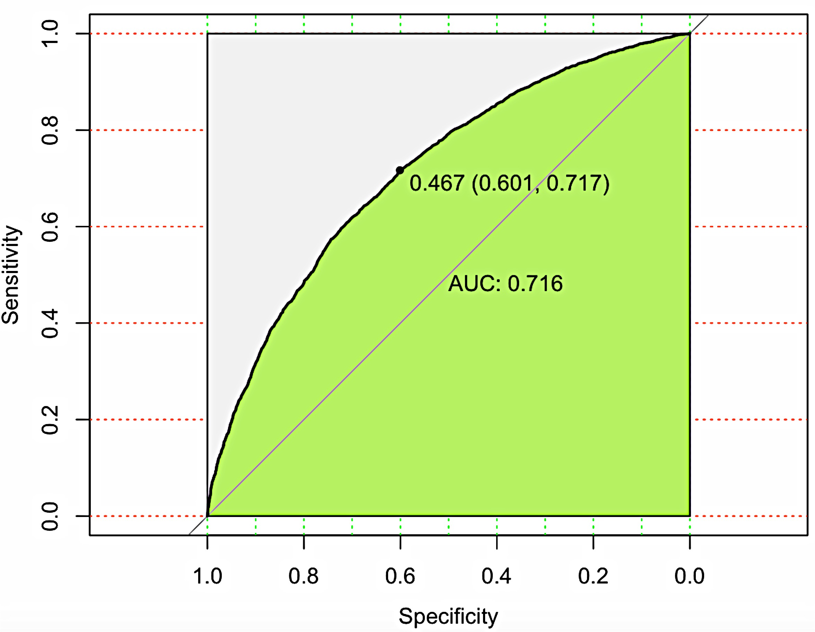
Results from Random Forest classifier
On the left, a screenshot showing performance parameters for Random Forest binary classifier.
Below, another ROC curve for the same model showing sensitivity (TPR) vs. specificity (TNR). Curve shows the values on the best threshold as per “youden” method, which maximizes distance from identity line (diagonal).

Slide 13
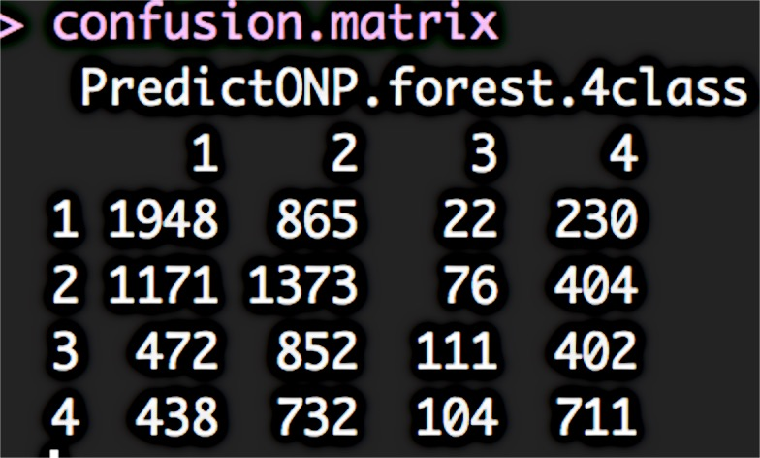
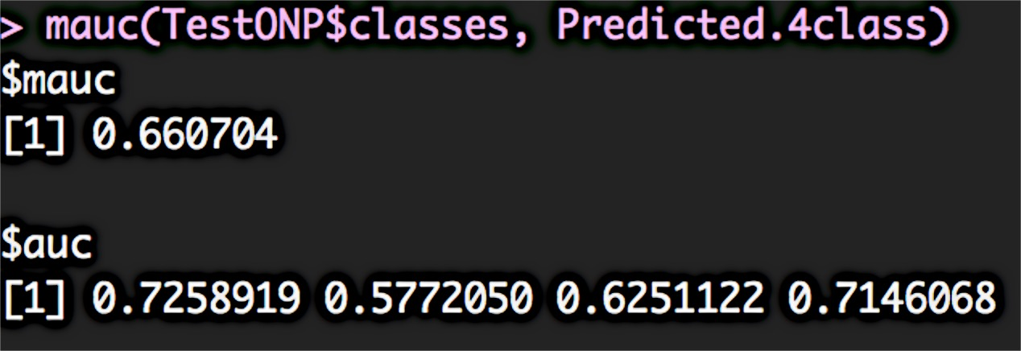
Results from Random Forest 4-class Classifier
Measuring performance statistics on Multi-Class Classifiers is not well established
Accuracy was measured here using the Exact Match Ratio. For an n-class problem this would be
Σ₁^{n}x_{ii} / Σ₁^{n}Σ₁^{n}x_{ij}
where x is an element of confusion
matrix for the n-class model.
AUC was measured using MAUC (Multi-Class AUC) method. MAUC calculates AUC for each class individually against all the other classes and averages the individual AUCs.
MAUC = Σ₁^{n}AUC(Class_{i}) / n
Accuracy obtained was 41.8 %
MAUC obtained was 66.07 %

Slide 14
all model summary
Linear Regression | Multiple R-squared: 0.0971 Adjusted R-squared: 0.09643 F-statistic: 145.2 on 22 and 29710 DF p-value: < 2.2e-16
Logistic Regression | Accuracy: 64.71 % Sensitivity: 65 % Specificity: 64.4 % AUC: 69.31 %
CART learning model | Accuracy: 61.6 % Sensitivity : 65.94 % Specificity : 57.12 % AUC: 62.4 %
Random Forest (2-class) | Accuracy: 65.83 % Sensitivity: 64.31 % Specificity: 67.39 % AUC: 71.6 %
Random Forest (4-class) | Accuracy: 41.8 % MAUC: 66.07 %

Slide 15
Conclusion
Recap of the project
Took the data set from UCI Machine Learning Repository, Capped, Factored and Scaled the data and ran it through a rigrous dimensionality reduction process.
Split the data into training and test sets, and tested 4 different regression and classification models on the data.
Tuned the models and compared them on key performance metrics to get the best model that fits the objectives of this project.
Challenges Faced | Solution
Data had a large number of mixed variables and was unsuitable for PCA, MFA | Cleaned the data and devised my own dimension reduction strategy to get best representative features
Did not fully understand the technical complexities of the models | Dug deep into literature review, studied pros and cons of the modeling algorithms, and techniques to tune the model parameters
Model results were not easy to interpret in the raw form | Explored and used various data visualization techniques

Slide 16
Acknowledgement & References
Acknowledgements:
Anirban Ghosh, my Springboard Mentor. Thank you for all your support and guidance.
The faceless online community of data scientists and R users and bloggers. Whatever question one might have, someone has asked it before!
Resources:
He Ren, Quan Yang. “Predicting and Evaluating the Popularity of Online News”. Link
Johannes Ledolter, “Data Mining and Business Analytics with R”
Rui Wang, Ke Tang, “An Empirical Study of MAUC in Multi-class Problems with Uncertain Cost Matrices”. Link
R-package library at CRAN (https://cran.r-project.org/web/packages/) and other places.
Springboard student resources

